Slide 1


SOFA
Framework
Presented by,
Dr. Shifa Sulaiman
Postdoctoral Researcher
ICAROS
UNINA
Dr. Shifa Sulaiman
Robotica Medica – SOFA

Slide 2


SOFA - Simulation Open Framework Architecture
Arose from research in 2006 in
Need for a collaborative framework for physics simulation
SOFA Project definition:
“Being the open-source reference for interactive and real- time applications”
Applications like:
Physics animation for Computer Graphics
Medical Simulation
All applications that need a common simulation tool for model creation, loading of animate a mesh, etc…
Very useful SOFA guide:
youtube.com/watch?v=KHTAgD1oG8Y&t=3850s

Slide 3
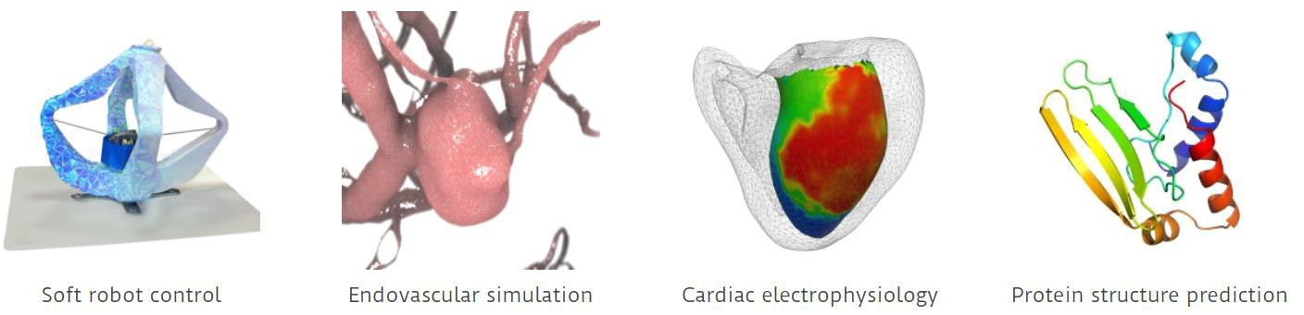
SOFA Framework
What really is SOFA? A physics engine!
It is a framework that implements a mathematical model describing the physics around us
Providing also all the algorithms that solve the physics at each time step
We are interested in using SOFA for:
Soft and rigid body dynamics
Medical Simulation
Robotics and Control

Slide 4
SOFA Software Architecture
Stable core:
written in C++: classes that implement the models, solvers, etc.
Open-source available on Github: LGPL license (download and use it for free!)
github.com/sofa-framework/sofa
Development of plugins (free-to-define license)
Multi-platform (Linux, Windows, McOS)
Documentation:
User online: sofa-framework.org/community/doc
API: sofa-framework.org/api

Slide 5


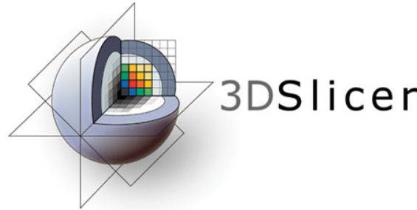
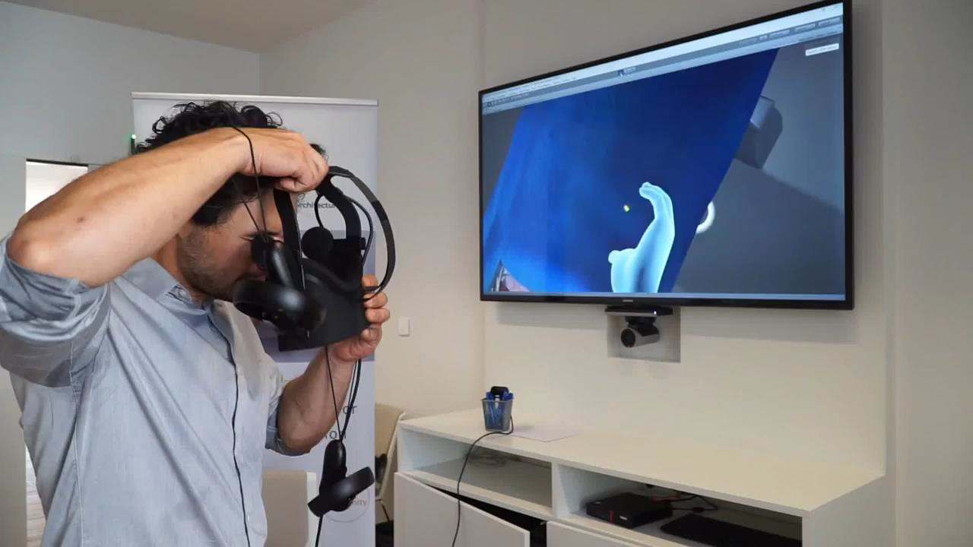
SOFA Application
InfinyTech3D (infinytech3d.com/), ROS, 3D Slicer
Create hyper-realistic simulations

Slide 6

SOFA Architecture
C++ classes
Contains all physical models, algorithms, and simulation mechanisms
Structure:
SofaKernel/: Base C++ classes that implement the API of SOFA
BaseModules
modules/: all the solvers and algorithms are here (ex: FEM)
examples/: examples of scenes and simulations
applications/plugins/: contains optional features, called plugins, that are disabled by default. But we can activate them if we need them (ex: SofaPython plugin)

Slide 7

Download & Install SOFA
Two ways:
Download Binaries sofa-framework.org/download/
Download the source code:
Configure with Cmake-GUI
Follow the tutorial step-by-step:
sofa-framework.org/community/doc/getting- started/build/linux/
Video tutorial:
youtube.com/watch?v=5pbT49t9M_k

Slide 8

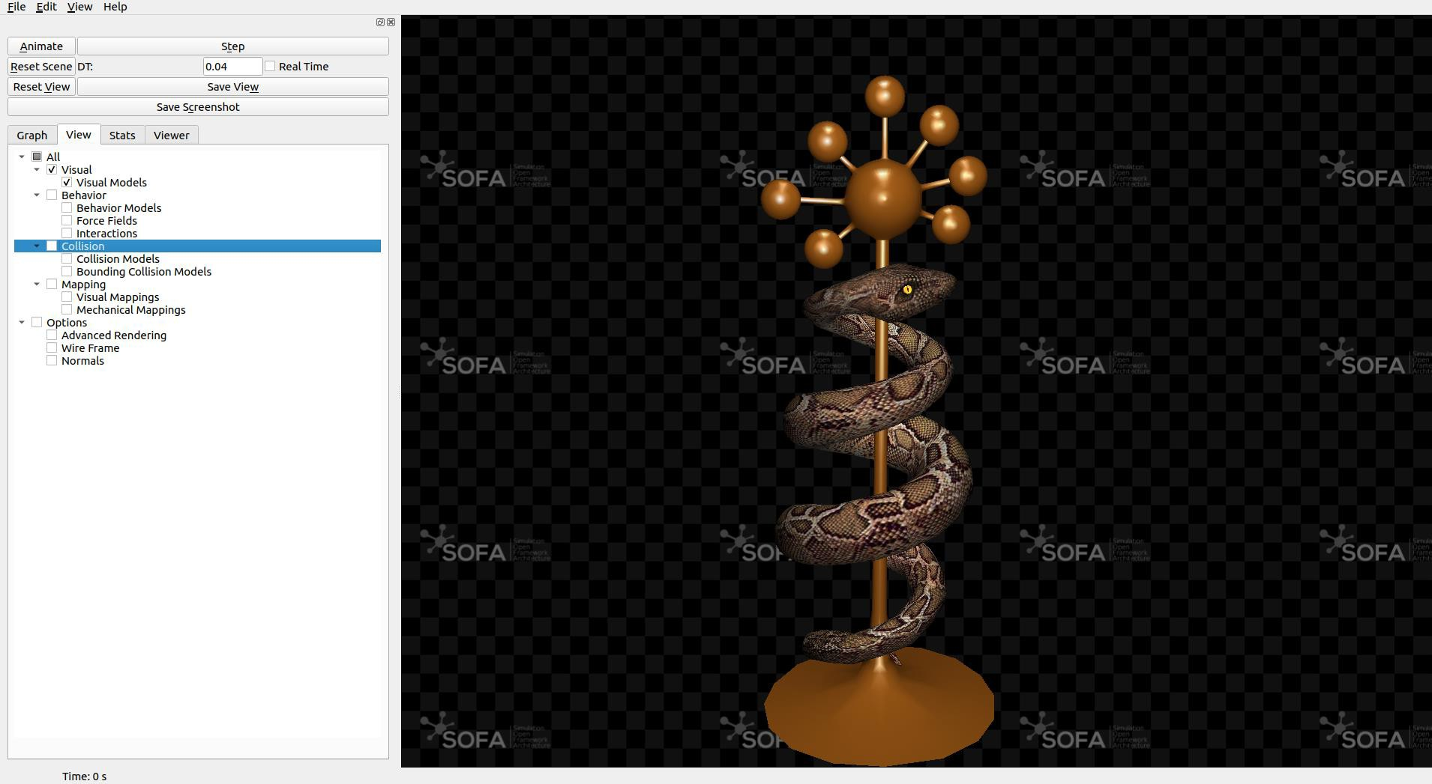
SOFA GUI
Build-in Graphical User Interface (GUI): GUI runSofa
Running the SOFA executable: $ ./runSofa

Slide 9

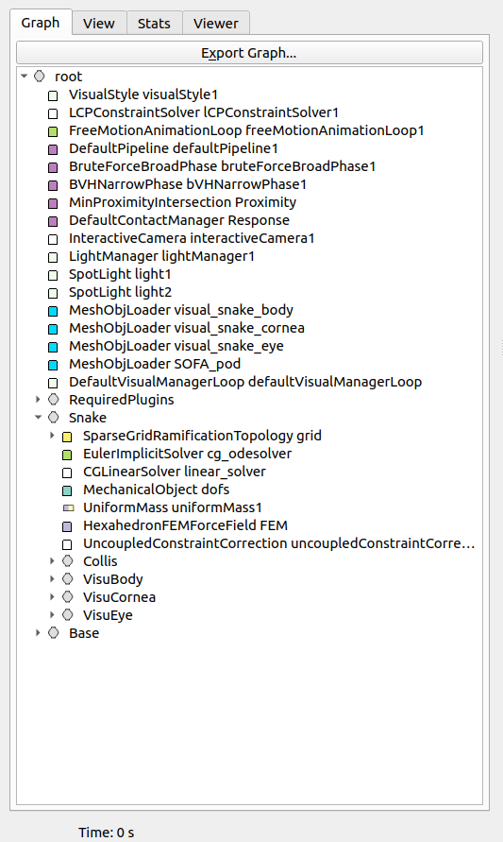
SOFA Main Principles
Scene Graph (Direct Acyclic Graph):
The graph describes the simulation in
every aspect
Composed of nodes in a hierarchy
root is the main, the others are child nodes (objects in the simulation scene)
Each node has Components: C++ classes, describing the physics of that object
Each Component has parameters called,
Data (topology, geometry, etc…)
It is described using XML or Python

Slide 10
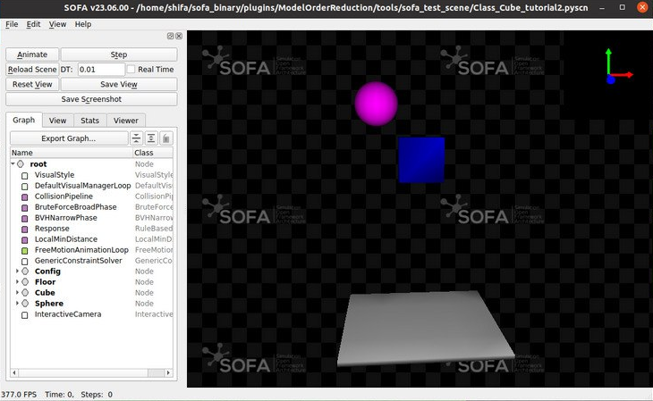
SOFA Main Principles

Slide 11
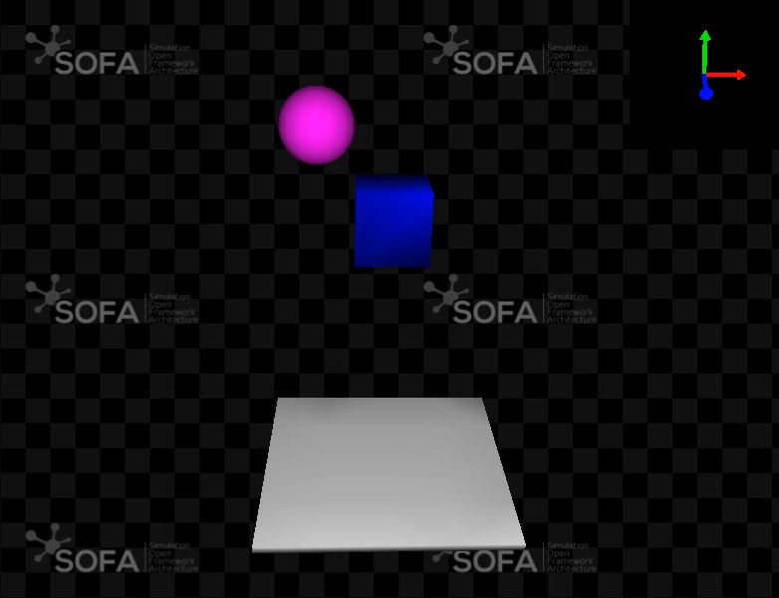
SOFA Main Principles

Slide 12
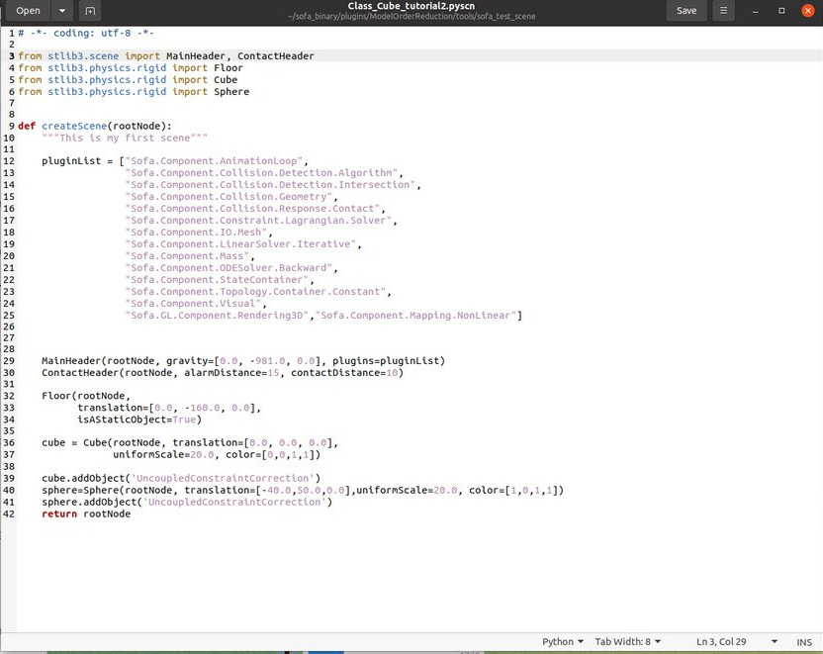
SOFA Main Principles

Slide 13
SOFA – Using Python Intrepreter
# Required import for SOFA within python
import Sofa
def main():
# Call the SOFA function to create the root node
root = Sofa.Core.Node("root")
# Call the createScene function, as runSofa does
createScene(root)
# Once defined, initialization of the scene graph
Sofa.Simulation.init(root)
# Run as many simulation steps (here 10 steps are computed)
for iteration in range(10):
Sofa.Simulation.animate(root, root.dt.value)
# Same createScene function as in the previous case
def createScene(rootNode):
#Doesn't do anything yet
return rootNode
# Function used only if this script is called from a python environment
if __name__ == '__main__':
main()

Slide 14
SOFA – Using runSofa GUI
def main():
# Call the SOFA function to create the root node
root = Sofa.Core.Node("root")
# Call the createScene function, as runSofa does
createScene(root)
# Once defined, initialization of the scene graph
Sofa.Simulation.init(root)
# Launch the GUI (qt or qglviewer)
Sofa.Gui.GUIManager.Init("myscene", "qglviewer")
Sofa.Gui.GUIManager.createGUI(root, __file__)
Sofa.Gui.GUIManager.SetDimension(1080, 800)
# Initialization of the scene will be done here
Sofa.Gui.GUIManager.MainLoop(root)
Sofa.Gui.GUIManager.closeGUI()

Slide 15
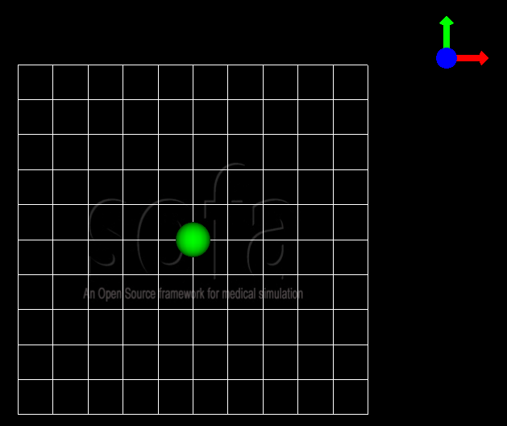
SOFA – Using runSofa GUI
def createScene(rootNode):
rootNode.addObject("VisualGrid", nbSubdiv=10, size=1000)
confignode = rootNode.addChild("Config")
confignode.addObject('OglSceneFrame', style="Arrows", alignment="TopRight")
# Creating the falling sphere object
sphere = rootNode.addChild("sphere")
sphere.addObject('MechanicalObject', name="mstate", template="Rigid3", translation2=[0., 0., 0.],
rotation2=[0., 0., 0.], showObjectScale=50)
#### Visualization subnode for the sphere
sphereVisu = sphere.addChild("VisualModel")
sphereVisu.loader = sphereVisu.addObject('MeshOBJLoader', name="loader",
filename="mesh/ball.obj")
sphereVisu.addObject('OglModel', name="model", src="@loader", scale3d=[50]*3, color=[0., 1., 0.],
updateNormals=False)
sphereVisu.addObject('RigidMapping’)

Slide 16
SOFA – Using runSofa GUI
rootNode.gravity=[0.0,-9.81,0.0]
rootNode.dt=0.01
totalMass = 1.0
volume = 1.0
inertiaMatrix=[1., 0., 0., 0., 1., 0., 0., 0., 1.]
# Creating the falling sphere object
sphere = rootNode.addChild("sphere")
sphere.addObject('EulerImplicitSolver', name='odesolver')
sphere.addObject('CGLinearSolver', name='Solver', iterations=25, tolerance=1e-05, threshold=1e-05)
sphere.addObject('MechanicalObject', name="mstate", template="Rigid3", translation2=[0., 0., 0.], rotation2=[0., 0., 0.], showObjectScale=50)
sphere.addObject('UniformMass', name="mass", vertexMass=[totalMass, volume, inertiaMatrix[:]])
sphere.addObject('UncoupledConstraintCorrection')

Slide 17
SOFA – Using runSofa GUI
# Creating the floor object
floor = rootNode.addChild("floor")
floor.addObject('MechanicalObject', name="mstate", template="Rigid3", translation2=[0.0,-300.0,0.0], rotation2=[0., 0., 0.], showObjectScale=5.0)
floor.addObject('UniformMass', name="mass", vertexMass=[totalMass, volume, inertiaMatrix[:]])
#### Collision subnode for the floor
floorCollis = floor.addChild('collision')
floorCollis.addObject('MeshOBJLoader', name="loader", filename="mesh/floor.obj", triangulate="true", scale=5.0)
floorCollis.addObject('MeshTopology', src="@loader")
floorCollis.addObject('MechanicalObject')
floorCollis.addObject('TriangleCollisionModel', moving=False, simulated=False)
floorCollis.addObject('LineCollisionModel', moving=False, simulated=False)
floorCollis.addObject('PointCollisionModel', moving=False, simulated=False)
floorCollis.addObject('RigidMapping')
#### Visualization subnode for the floor
floorVisu = floor.addChild("VisualModel")
floorVisu.loader = floorVisu.addObject('MeshOBJLoader', name="loader", filename="mesh/floor.obj")
floorVisu.addObject('OglModel', name="model", src="@loader", scale3d=[5.0]*3, color=[1., 1., 0.], updateNormals=False)
floorVisu.addObject('RigidMapping')

Slide 18
SOFA – Using runSofa GUI

Slide 19
SOFA – Using runSofa GUI
# Collision pipeline
rootNode.addObject('DefaultPipeline')
rootNode.addObject('FreeMotionAnimationLoop')
rootNode.addObject('GenericConstraintSolver', tolerance="1e-6", maxIterations="1000")
rootNode.addObject('BruteForceBroadPhase')
rootNode.addObject('BVHNarrowPhase')
rootNode.addObject('RuleBasedContactManager', responseParams="mu="+str(0.0), name='Response', response='FrictionContactConstraint')
rootNode.addObject('LocalMinDistance', alarmDistance=10, contactDistance=5, angleCone=0.01)
#### Collision subnode for the sphere
collision = sphere.addChild('collision')
collision.addObject('MeshOBJLoader', name="loader", filename="mesh/ball.obj", triangulate="true", scale=45.0)
collision.addObject('MeshTopology', src="@loader")
collision.addObject('MechanicalObject')
collision.addObject('TriangleCollisionModel')
collision.addObject('LineCollisionModel')
collision.addObject('PointCollisionModel')
collision.addObject('RigidMapping')

Slide 20
SOFA – Using runSofa GUI
#### Collision subnode for the floor
floorCollis = floor.addChild('collision')
floorCollis.addObject('MeshOBJLoader', name="loader", filename="mesh/floor.obj", triangulate="true", scale=5.0)
floorCollis.addObject('MeshTopology', src="@loader")
floorCollis.addObject('MechanicalObject')
floorCollis.addObject('TriangleCollisionModel', moving=False, simulated=False)
floorCollis.addObject('LineCollisionModel', moving=False, simulated=False)
floorCollis.addObject('PointCollisionModel', moving=False, simulated=False)
floorCollis.addObject('RigidMapping')

Slide 21
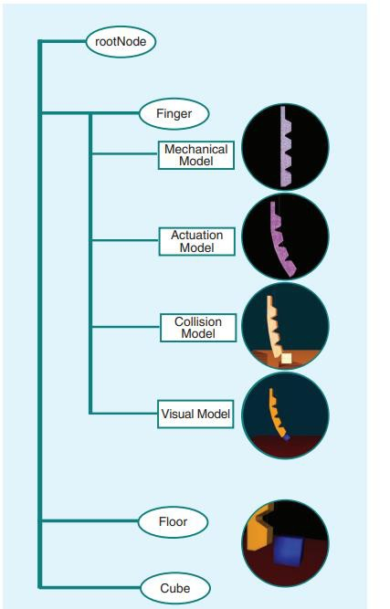
SOFA Main Principles
Scene Graph:
Each object can have several models in SOFA:
Mechanical model
Actuation model
Collision model
Visual model

Slide 22
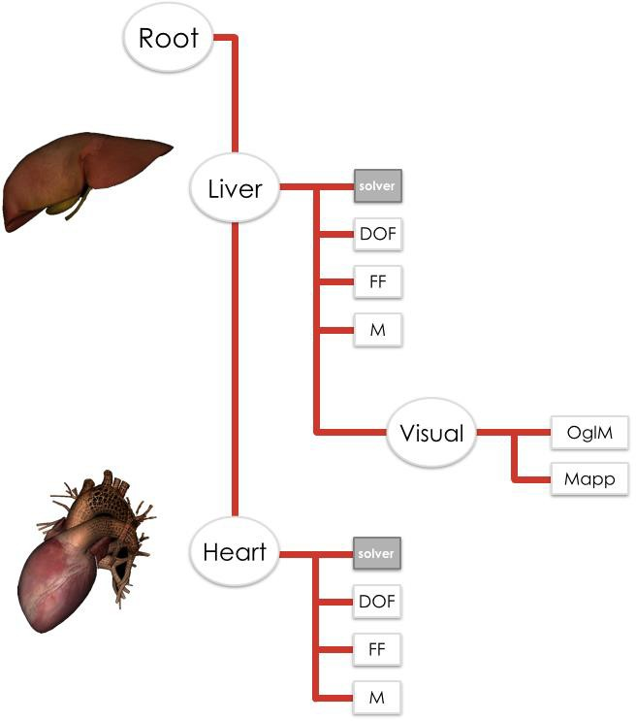
SOFA Main Principles
1. Scene Graph Example:

Slide 23
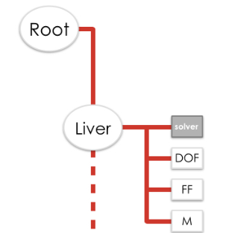
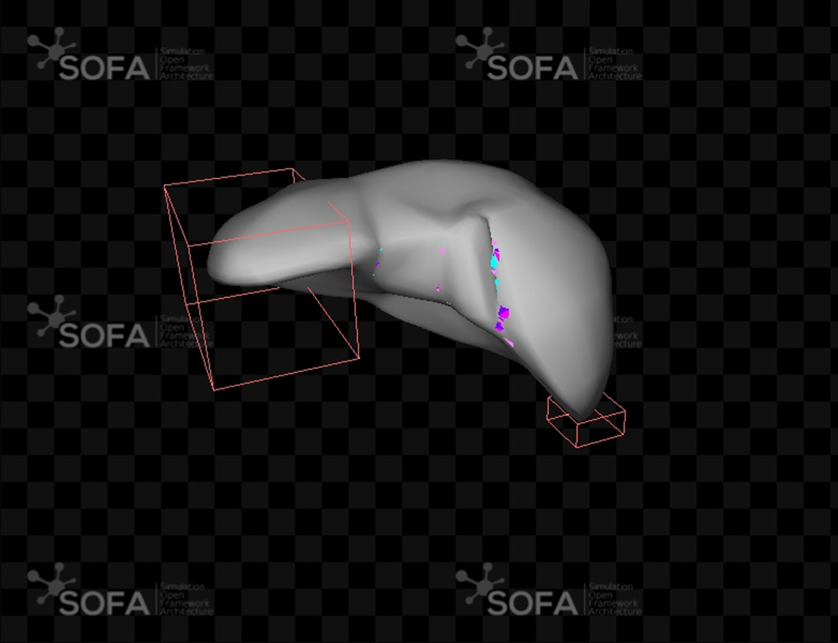
SOFA Main Principles
1. Scene Graph Example:

Slide 24
SOFA Main Principles
Animation loop & Visitors
Global variables: the time step, gravity field and type of contacts
Updates the scene, rules and orders for all simulation steps
The Animation loop:
It builds and solves the linear systems of differential equations that are present in the simulation
It solves collisions and constraints
It updates the scene
At each time step, the animation loop triggers each event through a Visitor mechanism

Slide 25
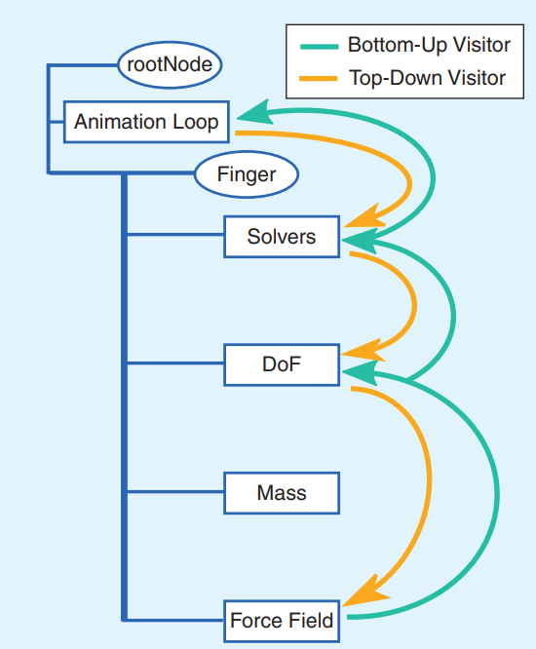
SOFA Main Principles
Several Animation loops:
DefaultAnimationLoop: solves the constraints and the collision together
FreeMotionAnimationLoop: uses the “free” solution. Collisions and constraints are added to the outcomes via a correction factor
Multistep: computes several collisions and integration in one single simulation time step
Visitors traverse the scene top-down and bottom-up and call the corresponding virtual functions at each graph node

Slide 26
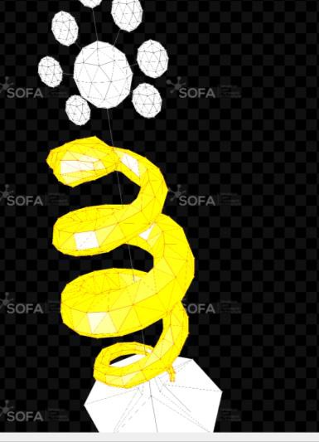
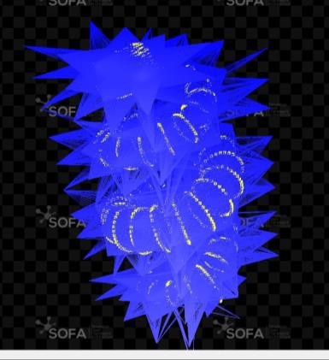
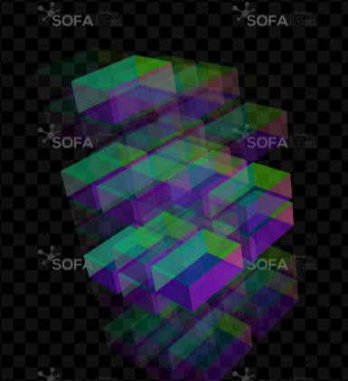
SOFA Main Principles
Mapping
Matching mechanism: gives the
correspondence between models
Each object can have several models in SOFA:
Mechanical model
Collision model
Visual model
Each model can rely on a different representation/topology

Slide 27

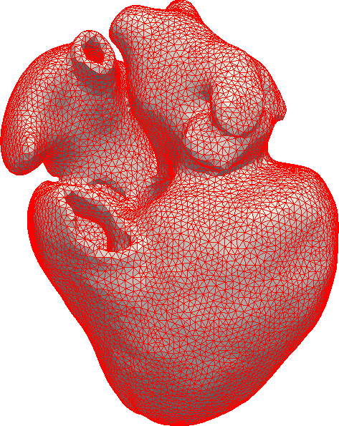
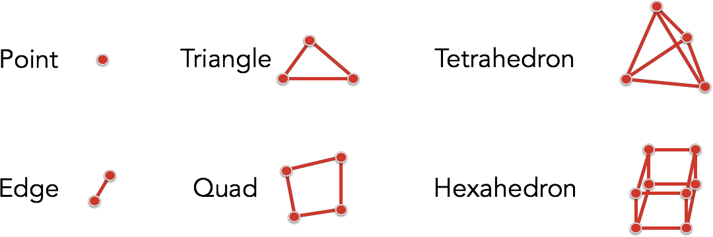
SOFA Simulation Features
Topology:
Describes the geometry
Discretization of the space in elements, with their connectivity (Finite element Method)
In real-time surgery simulation and can be hierarchically decomposed into k-cells
Mappings links the elements

Slide 28
SOFA Simulation Features
Collision:
Geometrical representation supporting collisions
Collision Pipeline:
Executed in the animation loop
Broad phase: create boxes around the object and the
intersection between them (no intersection = no collision)
Narrow phase (Distance maps, Layer depth image):
occur only if there is an intersection in the previous step
Computation of intersection (descending hierarchy)
Response: applying forces depending on what occurs. Penalty method (proportional force), Lagrange multiplier constraint (in FreeMotionAnimationLoop)

Slide 29


SOFA CORE + Plugins
SOFA Core has built-in features:
Topology loaders
Solvers: iterative, direct, etc…
Physical models: FEM based, Iper-elastic, etc…
Collision computation
Plugins:
Developed by research groups
Most used: SofaPython (3)
Ease the writing of a scene
Dynamic modifications

Slide 30

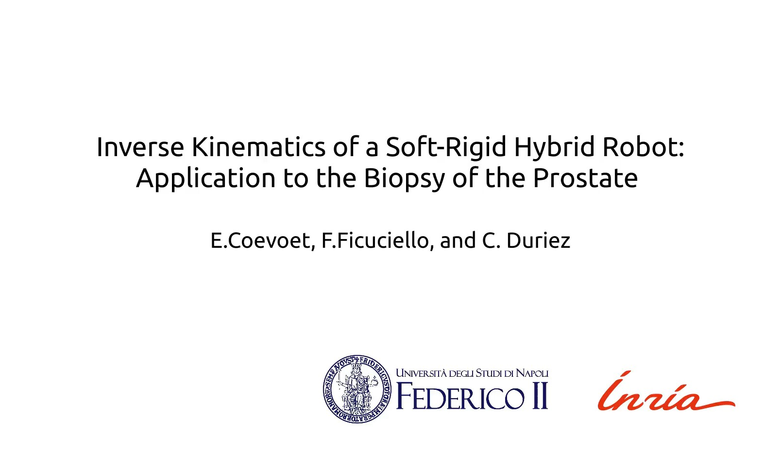
SOFA Application

